Slide 1
Recitation 10

Slide 2
Info
Jon Rutkauskas
Recitation: Tue 12-12:50
Office Hours: Tue 11-11:50 Thur 11-12:50 SENSQ 5806 (additional hours by appointment if needed)
On discord: @jrutkauskas
By email: jsr68@pitt.edu
Website: https://github.com/jrutkauskas/spring2019-449-rec
Ask me any questions you have!!!

Slide 3
Warmup Poll

Slide 4
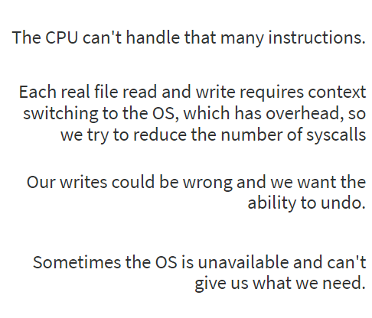
What is one Reason the c standard library buffers our file reads/writes? (and what even is a buffer?!)
When we buffer… (think about it when answering)

Slide 5
What is one Reason the c standard library buffers our file reads/writes? (and what even is a buffer?!)
A buffer is a space in memory the C library sets aside to hold a copy of part or all of our file, so when we request to read, it gets more than we need and can give us more characters without going to the OS. When we write, it writes to the buffer instead of the file until we ‘flush’ so we don’t have to talk to the OS as frequently
The CPU can handle pretty much anything we want – The CPU is incredibly fast, it’s I/O like the hard drive that’s really slow (~5ms)… yes, that’s slow
Context switches are really slow. Your OS has to save all your registers, change CPU modes, and a whole lot more. This is why all syscalls are slow and you should try to be efficient with them.
The correctness of our writes doesn’t matter, and the C library doesn’t really let you ‘undo’
The OS is always available to the process. Heck, it’s only briefly giving you the privilege of running on its system.

Slide 6
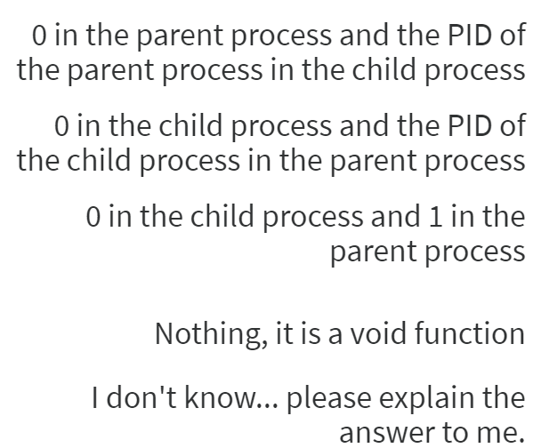
fork() makes an exact copy of your process. What does it return?

Slide 7
fork() makes an exact copy of your process. What does it return?
fork() returns the child’s pid in the parent… and 0 in the child.
^^ From the lecture slides
This is how we tell if we’re the child or not. Usually do an if statement on it, if it’s zero, do the child’s work, otherwise be a parent.
Don’t mix these up or you’ll be very confused on what your program is doing.
Also, remember that after doing fork(), the child process is an exact clone but runs independently (might get more time on the CPU than the parent, or finish sooner)

Slide 8
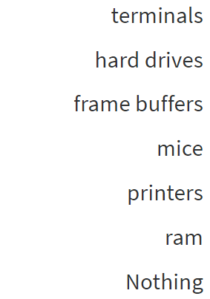
Which of the following is not able accessed through files in POSIX, generally?

Slide 9
Which of the following is not able accessed through files in POSIX, generally?
It’s all files
Like, everything is files
So much files
Just ls on /dev, and look at all those “files”
(Technically, even ‘nothing’ is a file, /dev/null)
Another fun file: /dev/urandom

Slide 10
Project 4
You know the shell, you use it all the time… it’s bash!
Haha, its job’s not that hard, right?
You could do that in your sleep, right?
Well, now you will, rhetorical 449 student!
Project 4 – The Shell Project
(Coming soon because I prepped these slides thinking the project would be released on time)

Slide 11
Project 4
Don’t worry, it’s not as nearly complicated as actual bash
Just a basic little interactive shell
The shell segments into very easy functions, so this project breaks down into nice chunks
Really, most of this project is just learning how to read man pages and work with functions
Lots of OS interactions – Good practice for 1550.

Slide 12
Project 4
You’ll make functions for your interactivity (start with the prompt and reading in the user input)
Then, you can write functions to parse the input and call other functions to handle things like running programs, changing directories, redirecting output, etc.
Remember, Top-Down design here
Then, you can read the man pages for the functions you need to call, and it’s pretty straightforward from there, just call them as requested and HANDLE ERRORS (of which there will be many)

Slide 13
Don’t Forkbomb Thoth
Don’t Forkbomb Thoth
Don’t Forkbomb Thoth
Don’t Forkbomb Thoth
Don’t Forkbomb Thoth
Don’t Forkbomb Thoth
Don’t Forkbomb Thoth
Don’t Forkbomb Thoth
Everyone will be upset… even (and especially)1550 students

Slide 14
Don’t Forkbomb Thoth
EVERY TIME YOU LOGIN
Run ulimit –u 40
This will limit you to only 40 processes (currently it’s set to something like 512)
That way, if you forkbomb, you’ll hit your 40 process max you’ve set and it will stop.
Then, all you have to do is disconnect from ssh, open it up again, log back in, and run the command “killall -9 myshell” (or whatever you called your executable)
This will kill every shell process you made, thus stopping the forkbomb
If you don’t do this, the system resources will get bogged down from your processes and EVERYONE will be slowed down to an unusable crawl and there will be nothing you can do except ask Jarrett to kill the processes for you (since you can’t get a bash process or killall process, etc)
So PLEASE, use this command. Please. And yes, you have to run it every time you login.

Slide 15
EMPHASIS
Repeated for emphasis:
use the following command:
ulimit -u 40
Every time you login
If you accidentally forkbomb, re-log in. Then you can run: killall -9 <the name of your shell executable>
and that will kill any of your shell processes.

Slide 16
Project 4
Message me if you have questions!
Even if I’m offline I’ll get a notification on my phone and will get back to you.

Slide 17
Lab 7
It’s out! – Basically, it gets you started on part of the project ;-)
We’ll be trying to use fork and execvp to run programs from our programs!
Actually, that part is done for you!
Follow along with the comments in the code.
You just have to do some error handling!
And get some good practice with man pages!
In fact, let’s get some man practice right now!

Slide 18
[thoth ~/private/cs449/lab7]:
man perror

Slide 19
perror(3) - Linux man page
Name
perror - print a system error message
Synopsis
#include <stdio.h>
void perror(const char *s);
#include <errno.h>
const char *sys_errlist[]; int sys_nerr; int errno;
Feature Test Macro Requirements for glibc (see feature_test_macros(7)):
sys_errlist, sys_nerr: _BSD_SOURCE
Description
The routine perror() produces a message on the standard error output, describing the last error encountered during a call to a system or library function. First (if s is not NULL and *s is not a null byte ('\0')) the argument string s is printed, followed by a colon and a blank. Then the message and a new-line.
To be of most use, the argument string should include the name of the function that incurred the error. The error number is taken from the external variable errno, which is set when errors occur but not cleared when successful calls are made.
The global error list sys_errlist[] indexed by errno can be used to obtain the error message without the newline. The largest message number provided in the table is sys_nerr-1. Be careful when directly accessing this list because new error values may not have been added to sys_errlist[]. The use of sys_errlist[] is nowadays deprecated.
When a system call fails, it usually returns -1 and sets the variable errno to a value describing what went wrong. (These values can be found in <errno.h>.) Many library functions do likewise. The function perror() serves to translate this error code into human-readable form. Note that errno is undefined after a successful library call: this call may well change this variable, even though it succeeds, for example because it internally used some other library function that failed. Thus, if a failing call is not immediately followed by a call to perror(), the value of errno should be saved.
Conforming To
The function perror() and the external errno (see errno(3)) conform to C89, C99, 4.3BSD, POSIX.1-2001. The externals sys_nerr and sys_errlist conform to BSD.
Notes
The externals sys_nerr and sys_errlist are defined by glibc, but in <stdio.h>.
See Also
err(3), errno(3), error(3), strerror(3)
Referenced By
explain(3), explain_lca2010(1), fmtmsg(3), genders_errnum(3), lam-helpfile(5),nodeupdown_errnum(3), psignal(3), rmt(8)

Slide 20
perror(3) - Linux man page
Name
perror - print a system error message
Synopsis
#include <stdio.h>
void perror(const char *s);
#include <errno.h>
const char *sys_errlist[]; int sys_nerr; int errno;
Feature Test Macro Requirements for glibc (see feature_test_macros(7)):
sys_errlist, sys_nerr: _BSD_SOURCE
Description
The routine perror() produces a message on the standard error output, describing the last error encountered during a call to a system or library function. First (if s is not NULL and *s is not a null byte ('\0')) the argument string s is printed, followed by a colon and a blank. Then the message and a new-line.
To be of most use, the argument string should include the name of the function that incurred the error. The error number is taken from the external variable errno, which is set when errors occur but not cleared when successful calls are made.
The global error list sys_errlist[] indexed by errno can be used to obtain the error message without the newline. The largest message number provided in the table is sys_nerr-1. Be careful when directly accessing this list because new error values may not have been added to sys_errlist[]. The use of sys_errlist[] is nowadays deprecated.
When a system call fails, it usually returns -1 and sets the variable errno to a value describing what went wrong. (These values can be found in <errno.h>.) Many library functions do likewise. The function perror() serves to translate this error code into human-readable form. Note that errno is undefined after a successful library call: this call may well change this variable, even though it succeeds, for example because it internally used some other library function that failed. Thus, if a failing call is not immediately followed by a call to perror(), the value of errno should be saved.
Conforming To
The function perror() and the external errno (see errno(3)) conform to C89, C99, 4.3BSD, POSIX.1-2001. The externals sys_nerr and sys_errlist conform to BSD.
Notes
The externals sys_nerr and sys_errlist are defined by glibc, but in <stdio.h>.
See Also
err(3), errno(3), error(3), strerror(3)
Referenced By
explain(3), explain_lca2010(1), fmtmsg(3), genders_errnum(3), lam-helpfile(5),nodeupdown_errnum(3), psignal(3), rmt(8)

Slide 21
Functions You May be using
perror
exit
execvp
signal
waitpid
WIFEXITED(status)
And more! (view the man page for waitpid to read about some more functions that are related to it)

